Slide 1
College Affordability Model Website Testing
By Norell Tagle

Slide 2
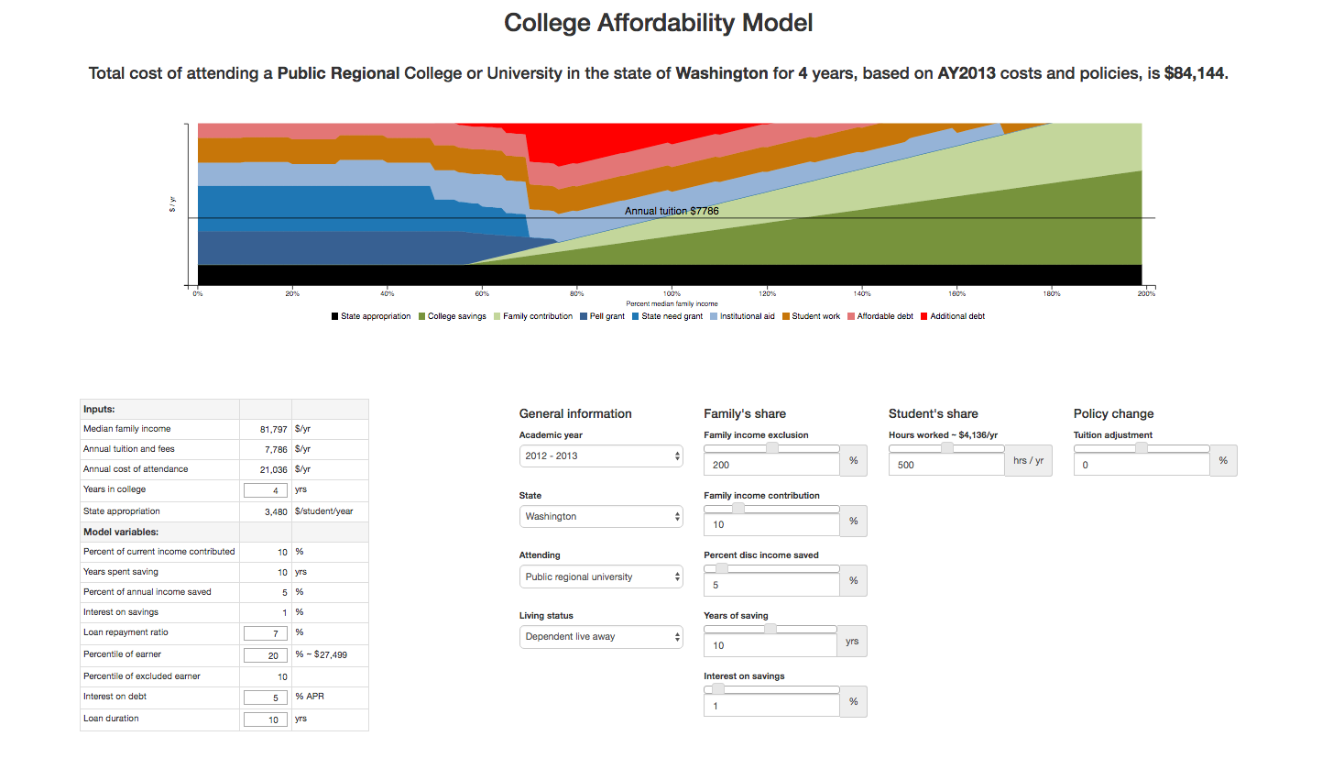
Introduction
Worked with Gautam Kumar, Larisa Kocsis, Professor Jim Fridley, and Professor Kelvin Sung
Website used by state legislators and staff to understand how students can pay for college
Notes:
Users would set the values accordingly and will show them results on top. Where does the money come from. Gautam was lead developer and implemented the back end and website. Larisa was UI and implemented some visualizations including pie graphs on the.

Slide 3
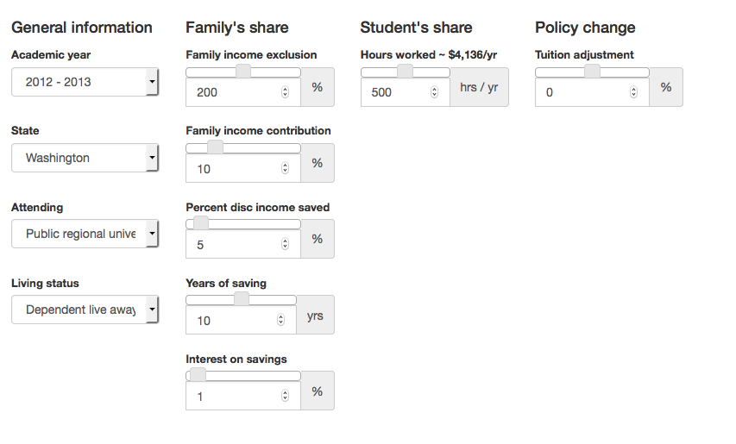
Problem
Too many menus and sliders to be tested
Single combination of any of these can cause a crash
How is someone going to test multiple inputs all the time?
Notes:
Because it is being used by state legislators, it is important that the site has no crashes or bugs. To go through every single iteration would be tedious.
Important Especially when new ones are added

Slide 4
Problem
Having someone check after every update is inefficient
Notes:
Tester could miss some iterations.

Slide 5
Solution
Automated test that could be run by a single click
Crash detection and logging
Data validation
Notes:
Click on a script or jar file that would open up the program. An automated test that would run through the all table entries, drop downs and menus. User would click on a given script command that would run the .jar file or program. Dynamic as well so that when there a different number of sliders (for different state), then the test will still work

Slide 6
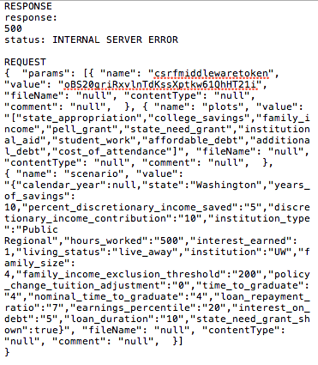
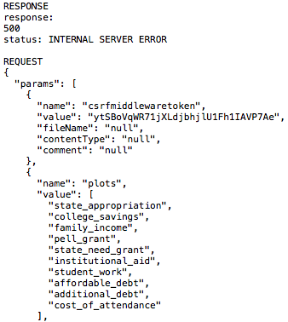
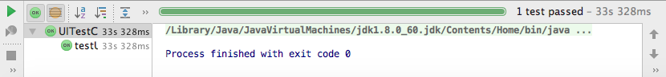
Solution
Log errors into a HTTP Archive (HAR) file
Took screenshot of web page for UI faults
Compared values with a correct set
Notes:
HAR file has time stamp so testers can keep track. Json parser. Had to remove some extra quotes and commas. One set would be correct set of values.

Slide 7


Solution
Selenium WebDriver
JUnit
JsonParser
Notes:
Selenium to grab elements from the webpage, then use them to run JavaScript and jQuery commands. JUnit to perform data validation testing. Would take in a nominal set of values, change them on webpage, and compare value on webpage to correct value.

Slide 8

Result
(Link)
Notes:
3 main methods: iterate through table entries, drop down menus and sliders. Not exact speed. Really depends on computer and server response. Typically would take around 5 - 7 minutes. As you can see, as the values change, the graph and text above change as well.

Slide 9
Conclusion
Selenium is a powerful tool to automate any web browser
Learned an important aspect of quality assurance
Collaboration
Notes:
Selenium can be used for personal uses as well.
Checking if the development is faulty or not
Collaboration with different groups of people (Jim doing research and data gathering, figuring out how these numbers are calculated). Not just a technical crew.

Slide 10
Next Steps
Headless testing
PhantomJS
Selenium’s HTMLUnitDriver
More JUnit testing
A graph of the run times of each request sent to server
Notes:
Created a framework for future testers
The test is close to being done
Headless testing can be done with PhantomJS and Selenium’s HTMLunitdriver
Run time can be obtained from the HAR file. Get those run times, plot them on a line graph just to see how fast or slow the server is responding

Slide 11
Thank you!

